Slide 1
Setting Up Application Environment
Create An IBM Cloud Account

Slide 2
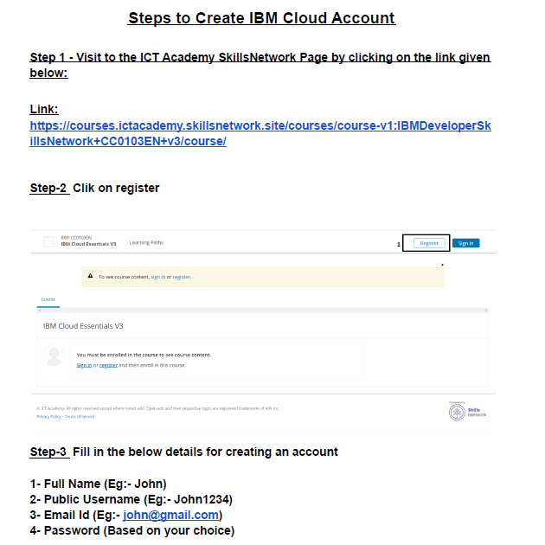

Slide 3
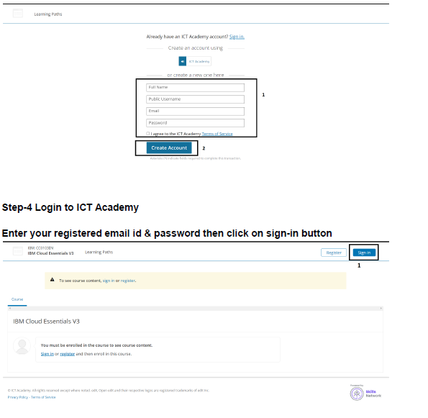

Slide 4
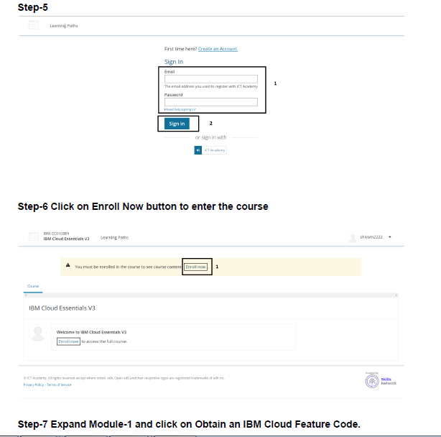

Slide 5
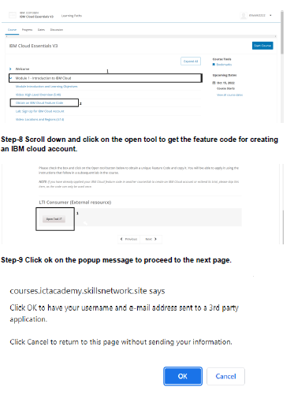

Slide 6
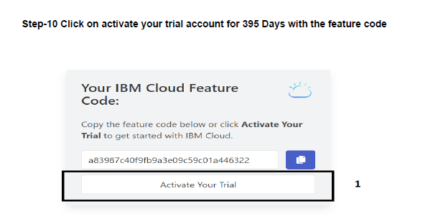

Slide 7
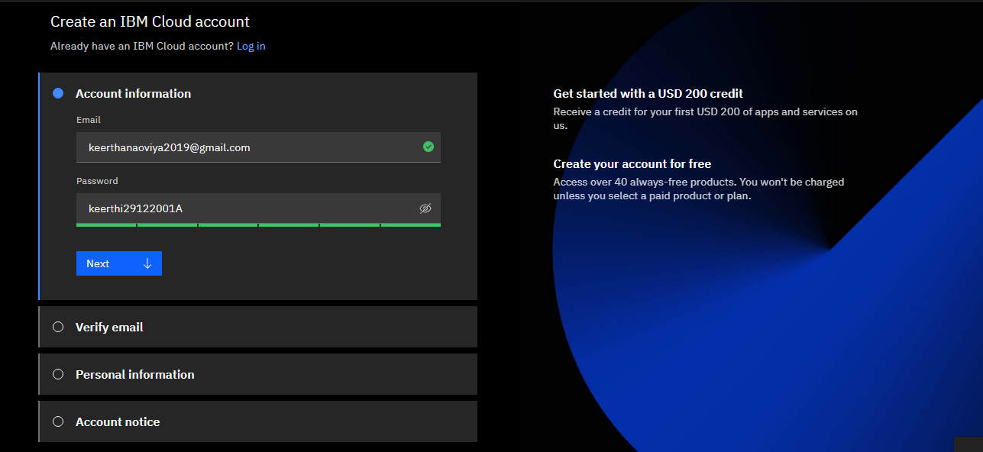
Step-11 Provide the same credentials i.e email id & password used for ICT Academy account creation and click on next to get the OTP on the registered email id.

Slide 8
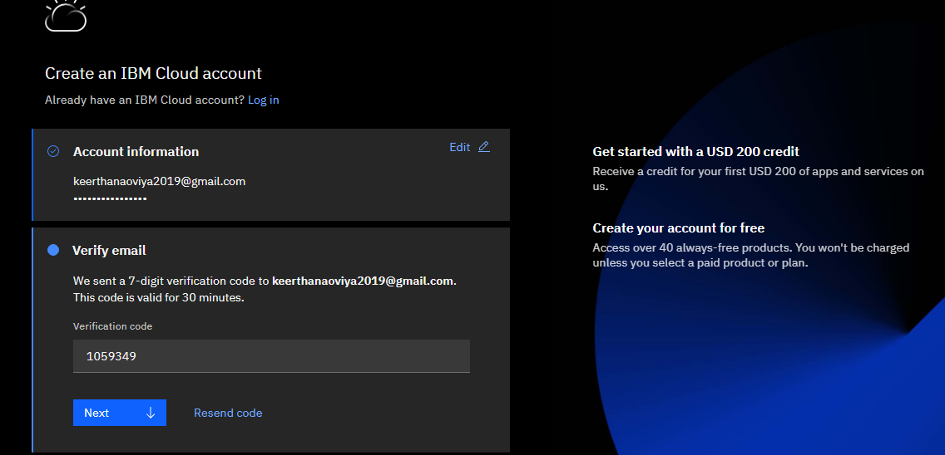
Step-11 Provide the received OTP on the registered email id and click on next

Slide 9
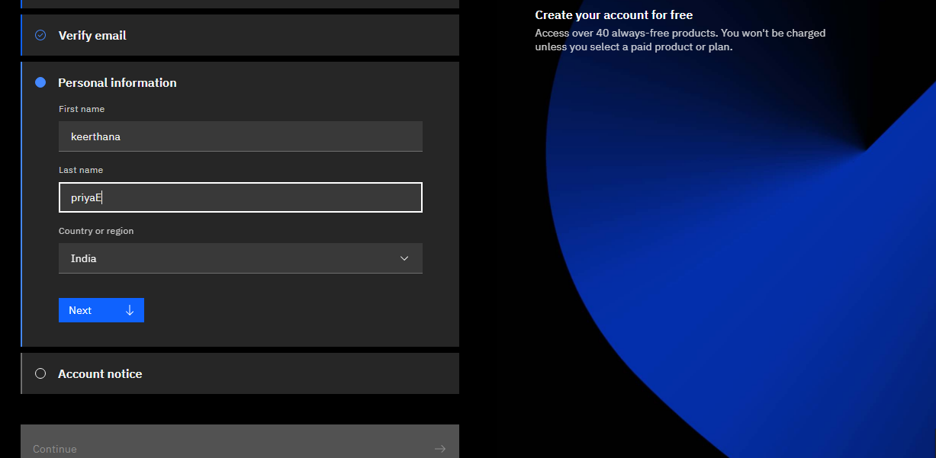
Step-12 Provide personal information and click on next

Slide 10
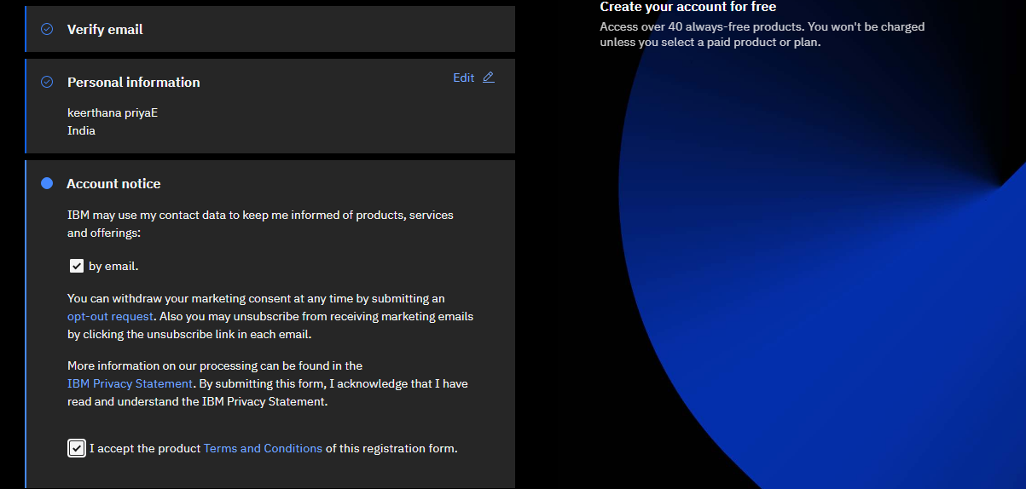
Step-13 Accept the terms and conditions then click on continue

Slide 11
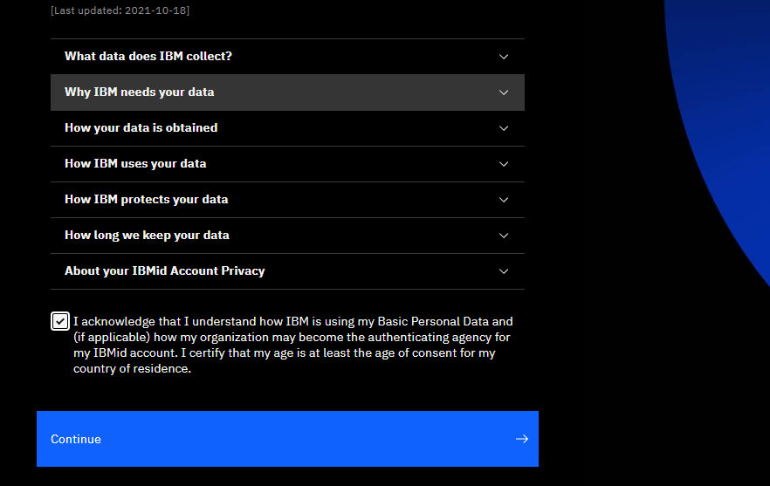
Step-14 Review account privacy notice mark the checkbox then click on continue

Slide 12
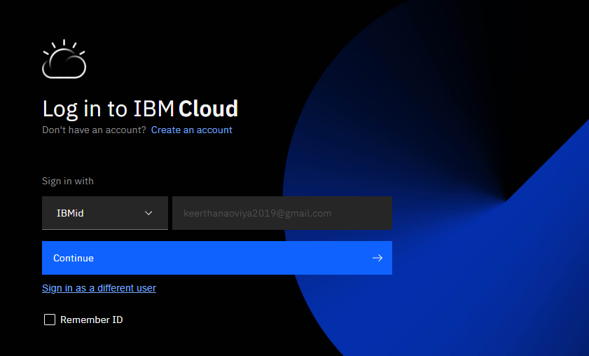
Step-15 Refer to Step-9 to copy the feature code or continue with the filled feature
code then click on create account

Slide 13
